Slide 1
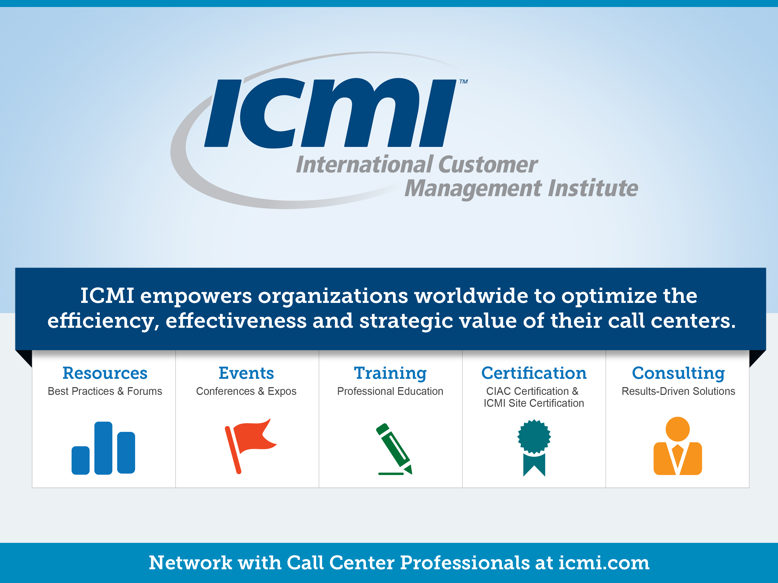

Slide 2

Moving Metrics Into Action
Pre-6
Tim Montgomery, Managing Partner, Culture.Service.Growth (CSG)

Slide 3
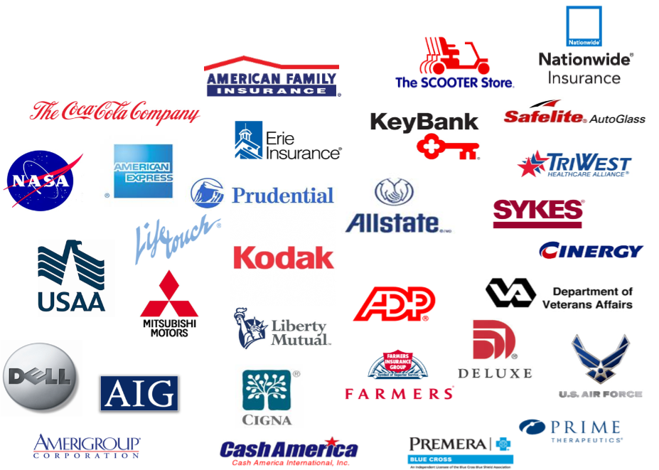



CSG’s Founders have advised some of the world’s most recognized service organizations

Slide 4
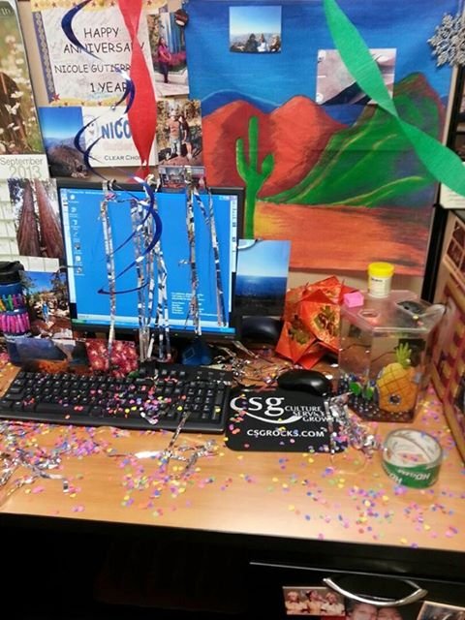
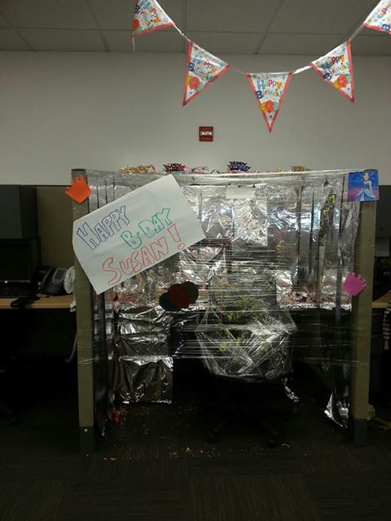
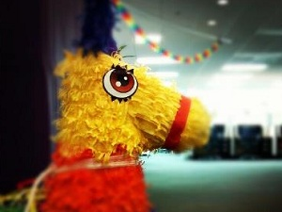
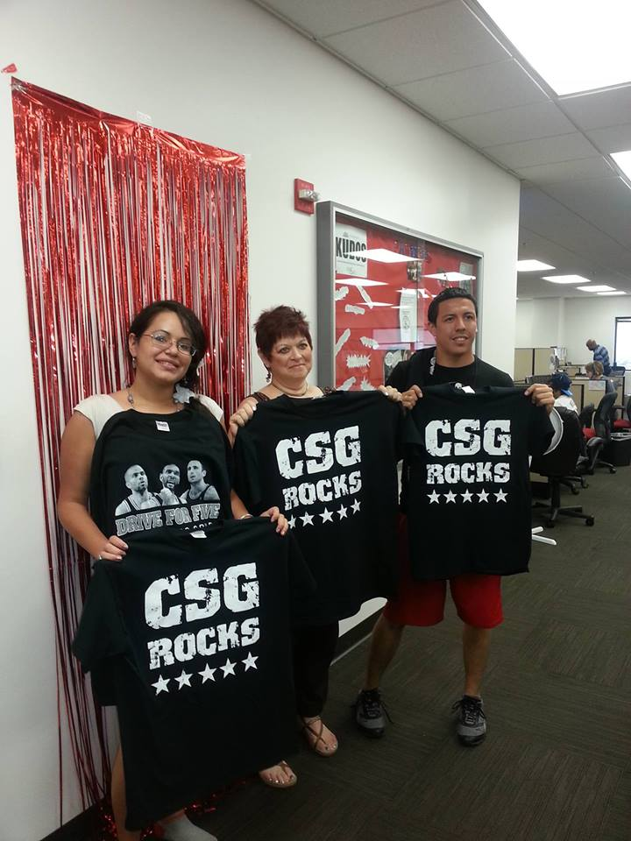
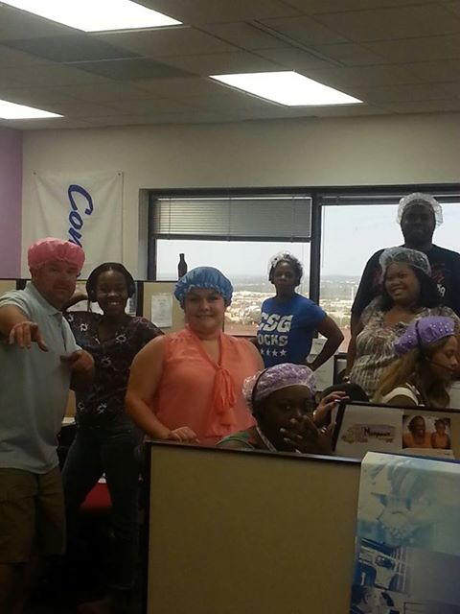

Slide 5

“World Class is NOT
something you deliver, it is a RESULT
of something you are” John DiJulius

Slide 6

Metrics are Everywhere

Slide 7


Slide 8
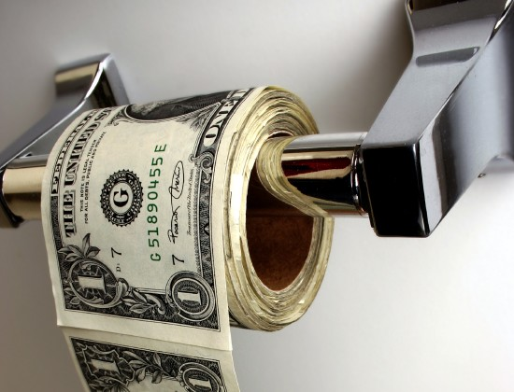
Lost productivity cost
companies $800 Billion a year

Slide 9

Call Center Metrics are the Key Ingredient to an Employee Focused Culture

Slide 11

The Call Center Leader
If it wasn’t for that math…

Slide 12
Random
IS
Planned

Slide 13
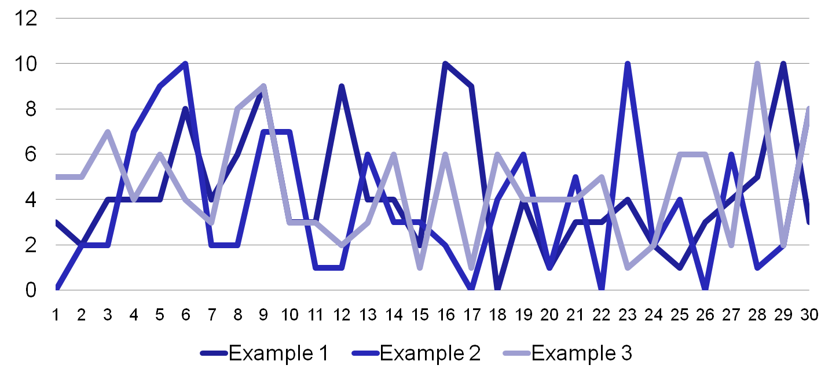
150 Calls arriving minute by minute in an interval
Notes:
The Profession

Slide 14
Staffing
IS
Math

Slide 15
@ a 6 minute handle time we’d staff 35 people to meet an 85/30 SL for the three examples.
Notes:
The Profession

Slide 16
MC Hammer
IS
Right

Slide 17
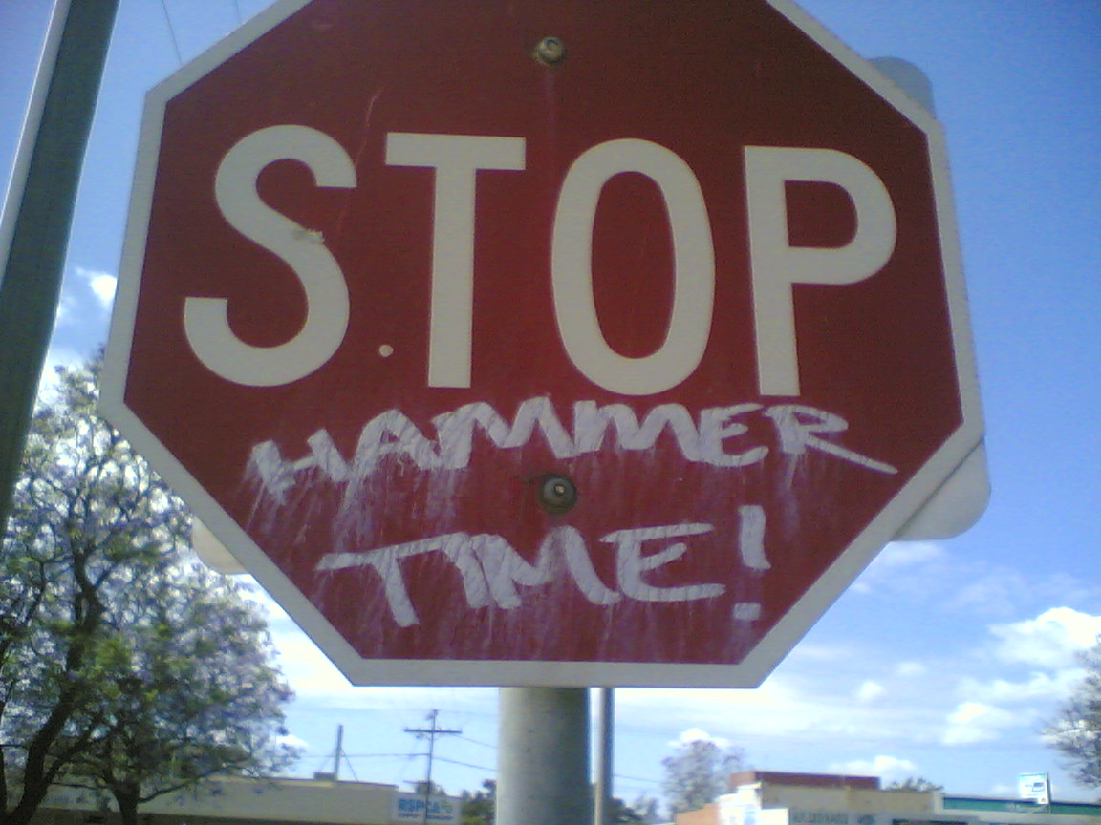

Slide 18
@ a 6 minute handle time we’d staff 35 people to meet an 85/30 SL for the three examples.
Notes:
The Profession

Slide 19
Understaffed - The ACD will hold them
Notes:
The Profession

Slide 20
Overstaffed - More Idle Time
Notes:
The Profession

Slide 21
Average or Close will not cut it
Notes:
The Profession

Slide 23
82% of the intervals within the service level objective
86% of the intervals within the ASA objective
89% of the intervals within the answer rate objective
82% of the intervals within the abandon rate objective
79% of the intervals within the call forecast objective
50% of the intervals within the AHT forecast objective
90% of the intervals within the agent adherence objective

Slide 24
Above – doesn’t add much to the customer’s experience
Below – negatively impacts the customer’s experience
Above – adds additional idle time to every agent
Below – takes idle time away from every agent

Slide 25
Above – doesn’t add much to the customer’s experience
Below – negatively impacts the customer’s experience
Above – adds additional idle time to every agent
Below – takes idle time away from every agent

Slide 26

Measurement Traps
Focused on Self
Looking Backwards
FAITH in Numbers
Gaming the Metrics
Sticking TOO Long

Slide 27
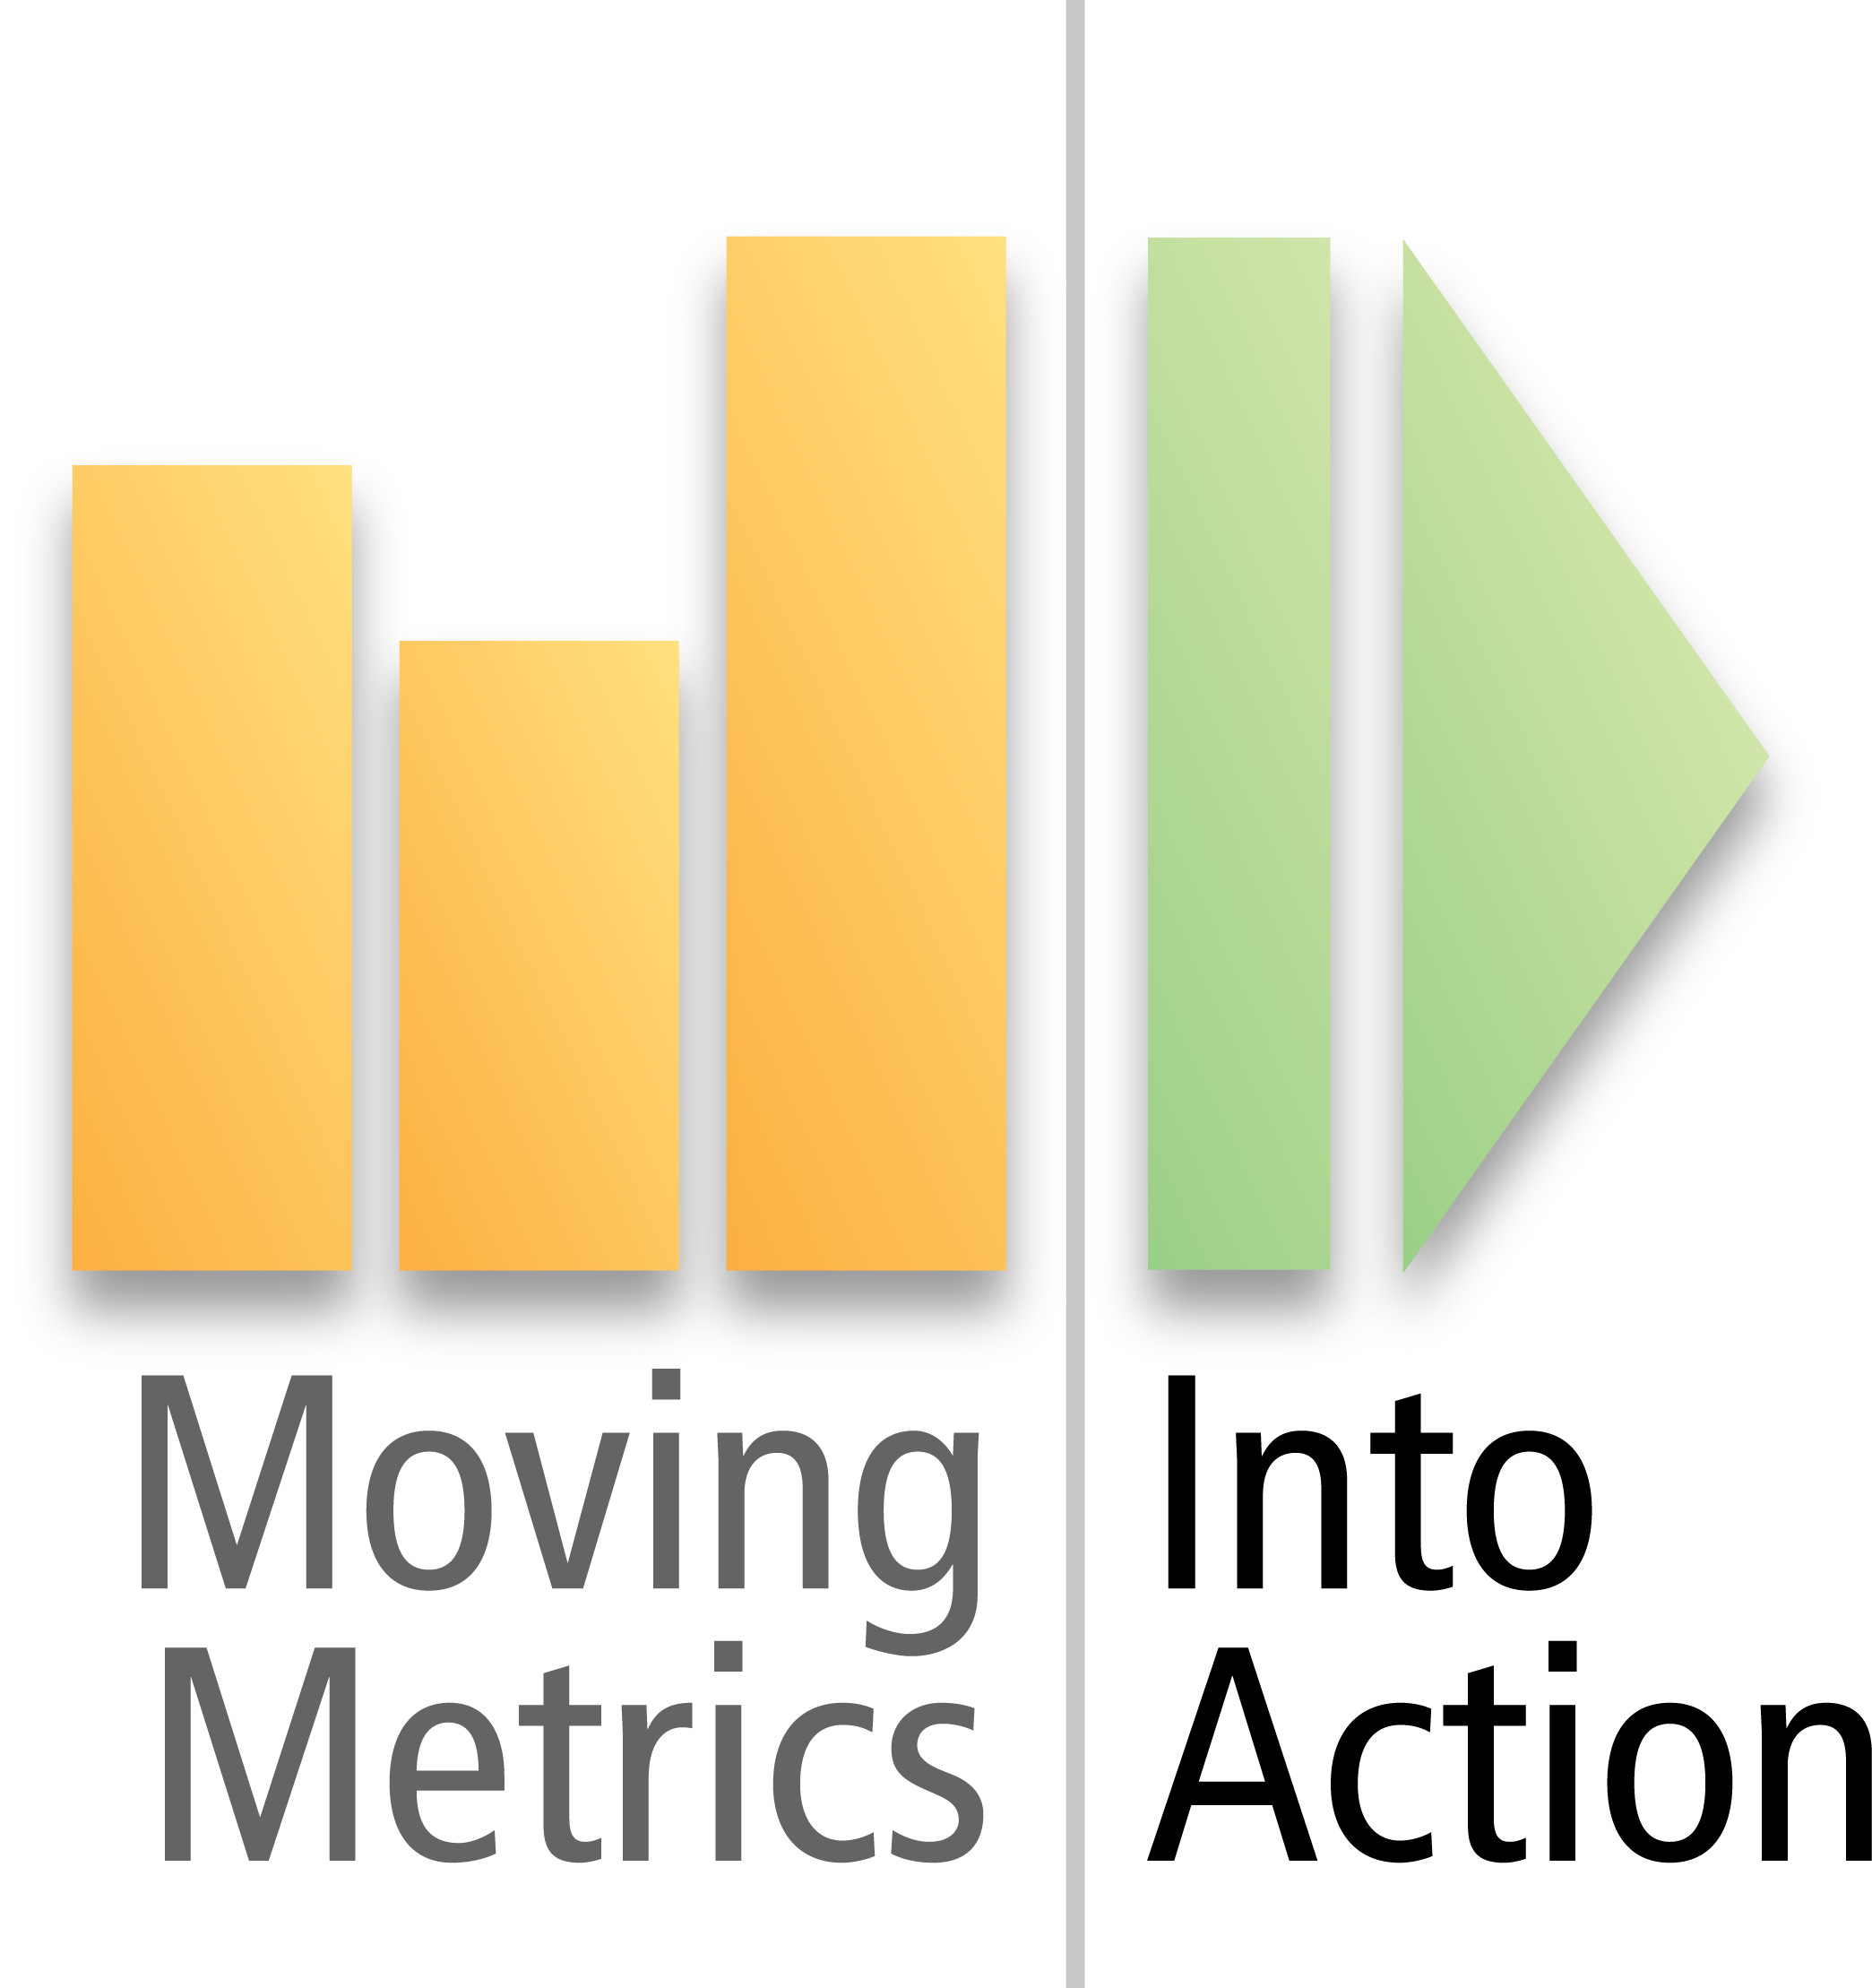
Internal Measures Not Connected with the Customer or Competition
Why does the customer care?

Slide 28
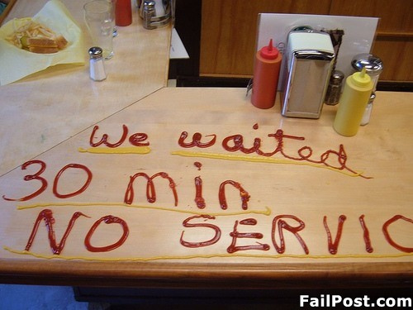
Service Level/ASA
Is the door open when promised?
How much of my time are you willing to take?
Should I begin to look for an alternative?

Slide 29
Abandon/Answer Rate
I’m too busy right now
I don’t have tolerance for wasting time
I have alternatives

Slide 30
Too Much Time Spent Analyzing the Score
More Time On the Game Film and Moving Players

Slide 31


What is Planned?
What do I Have?
What is Down the Road?
…Adjust Based on Future
NOT Past
Svc Level
ASA
Abandon
Adherence

Slide 32
Measures Put In Place Because Everyone Else Does It
Understand That Size Makes Call Centers Different

Slide 33
80/20 SLO
250 Second Talk Time
50 Second ACW
25
calls
7 Agents
60% Occ
12 Agents
70% Occ
50
calls
Savings of 2 Agents
100
calls
21 Agents
80% Occ
Savings of 7 Agents
300
calls
57 Agents
88% Occ
Savings of 27 Agents

Slide 34
Measures With Holes That Lead to Excuses
“Wishful Thinking and Denial”
…Beyond the 4 Walls

Slide 35
GATEWAY - I Built This Company, I Can Save It – Fortune Magazine
Many of these changes hurt more than just morale. They hurt business. For example, one policy put a time limit on customer-service calls; reps who spent more than 13 minutes talking to a customer didn't get their monthly bonuses. As a result, workers began doing just about anything to get customers off the phone: pretending the line wasn't working, hanging up, or often -- at great expense -- sending them new parts or computers. Not surprisingly, Gateway's customer satisfaction rates, once the best in the industry, fell below average. What's more, many customers stopped recommending Gateway to their friends and families; Gateway's referral business -- once 50% of total sales -- fell to about 30%

Slide 36
Comparing Apples to Watermelons and the resulting AVERAGE
Give leaders the tools to COACH the solution

Slide 37
20 Minute AHT
Caught on 3 Long Calls a Day (20 mins)
30 Minutes of Other Non-Adherence Time per Day
5 Minute AHT
7 Hours of Phone Time
Caught on 3 Long Calls a Day ( 5 mins)
7 Hours of Phone Time
30 Minutes of Other Non-Adherence Time per Day
79%
89%
Notes:
t

Slide 38
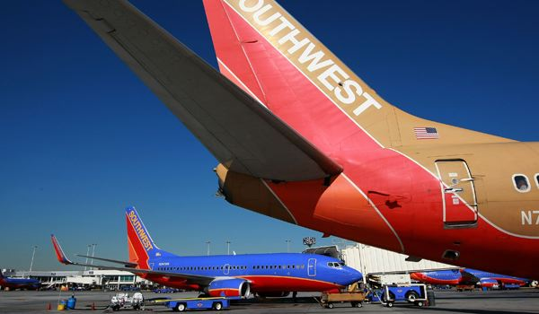
Herb Kelleher On Coaching… You don't have time to do anything else until you accomplish that; focus all of your time and then the rest of it will fall into place and be easy.

Slide 39
Agent Empowerment Limited by the Numbers
Outline the Behaviors First, Then the Drivers

Slide 40
Schedule Adherence and Quality
Call Volumes
Staffing Needs
Everyone’s Workload
Handle Times
Real-Time Activities
Accessibly Results (SLO, ASA, Abandon)
Customer Satisfaction
Forecast Accuracy

Slide 41
Quality Monitoring Becomes a Numbers Game
Connect Quality to Improvement the Entire Process

Slide 42
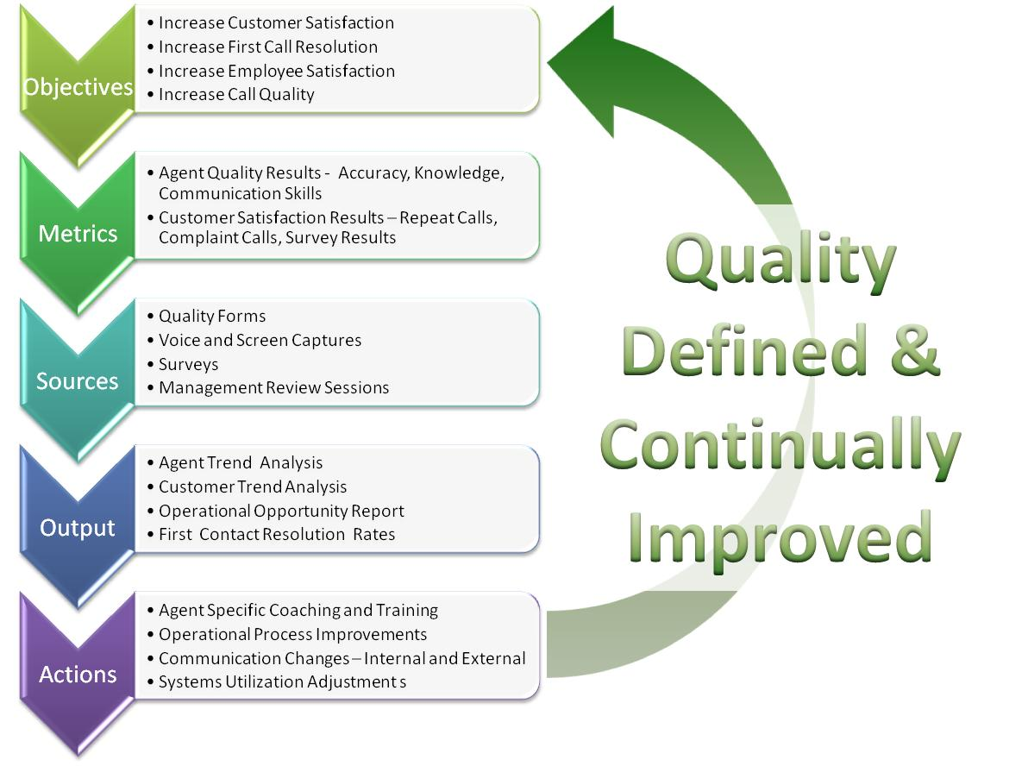

Slide 43
Ongoing Internal and External Process Changes, but Static Goals
Leaders That Can Coach to the Exceptions and Change

Slide 44
USAA - Positioning Supervisors for Success with a Call Center Curriculum (From CC Management Review)
“Many times, supervisors are promoted from within; we select the best agent to be the next supervisor. They are the leaders of your customer service staff and the “voice” of your company – but have you equipped them with more than a Stephen Covey book? Invest in the future of your company by giving new and upcoming supervisors a thorough understanding of how to run an effective and efficient call center – from communication skills to Erlang C.”

Slide 45
Agents Can’t Make the Connection to the Why
Educate Everything About the Driver and the Real Results

Slide 46


Slide 47
Reliance on After Call Coding for Front-line Feedback
Engage Them to Help Fix the Process – and Reward Them

Slide 48

In a Year…The Average Call Center Agent Talks To 10,000 Customers
Turn Calls
Into Ideas

Slide 49

Senior Management Just Doesn’t Get It….

Slide 50
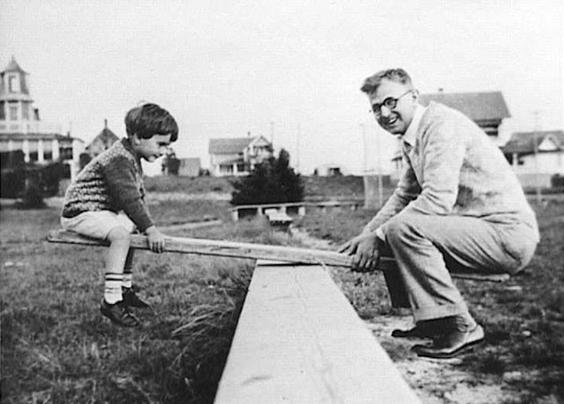

Slide 51

Many
Long
QUICK

Slide 52

AGENTS – 40
SLO – 80/20
QUEUE – 19%
IDLE – 17%
MINS - 10

Slide 53
AGENTS – 138
SLO – 80/20
QUEUE – 37%
IDLE – 6%
MINS - 3.5

Slide 54


Slide 55

Understand the Driver
Contact centers don’t create most of their calls
Determine the main driver (shipments, policies, members, etc…)
Set goals for reducing the ratio
Dig deeper by using the front line

Slide 56
Improvements impact both “how many” and “how long”
Break down the results by category – try to move the top ranking ones to automation
Positively Impacts satisfaction of everyone involved in the call center – leadership, customers, front-line and shareholders.
First Contact Resolution

Slide 57
Really Understand “Why”
Create way for the front-line to share the real reasons customers are calling…beyond coding!
Engage the front line to eliminate “dumb contacts”
Use the insight to fix the call center and help other departments realize their contribution

Slide 58
Minimize Agent Variance
Compare “apples to apples” – everyone with the same telephone skills to each other – not teams…
Look for outliers and uncover root causes
Use observation to its full advantage (remote or side-by-side) – Metrics tell just part of the story

Slide 59
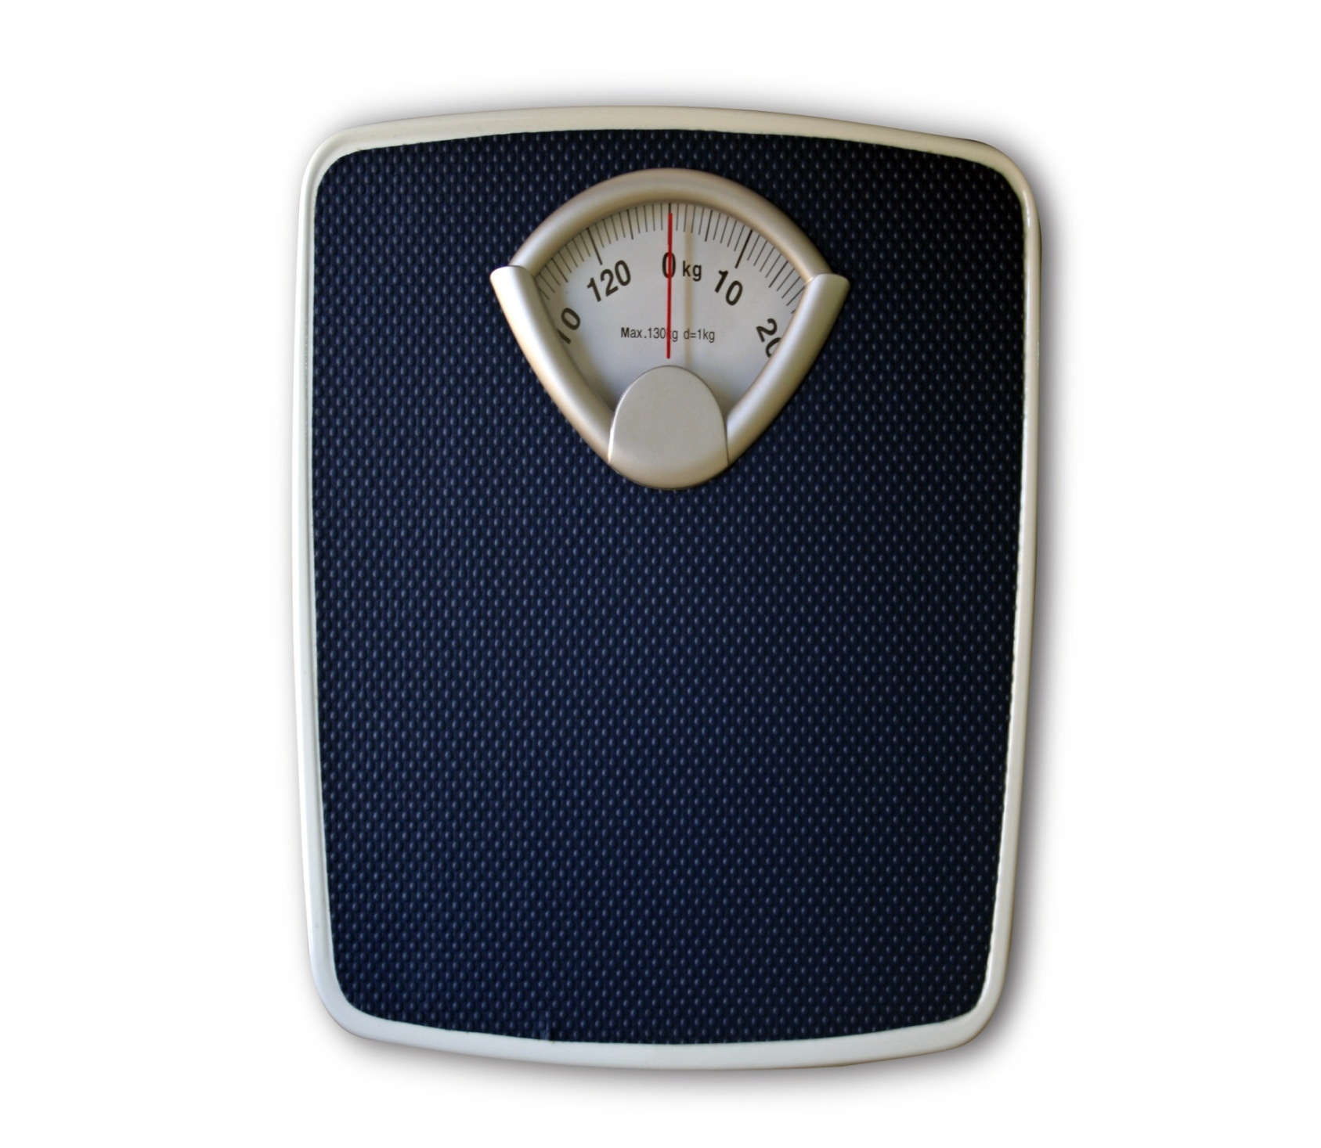
You Can’t lose 20 pounds in a day

Slide 60

timm@csg-email.com

Slide 61
Thank you for attending Please complete your session evaluation

